Slide 1
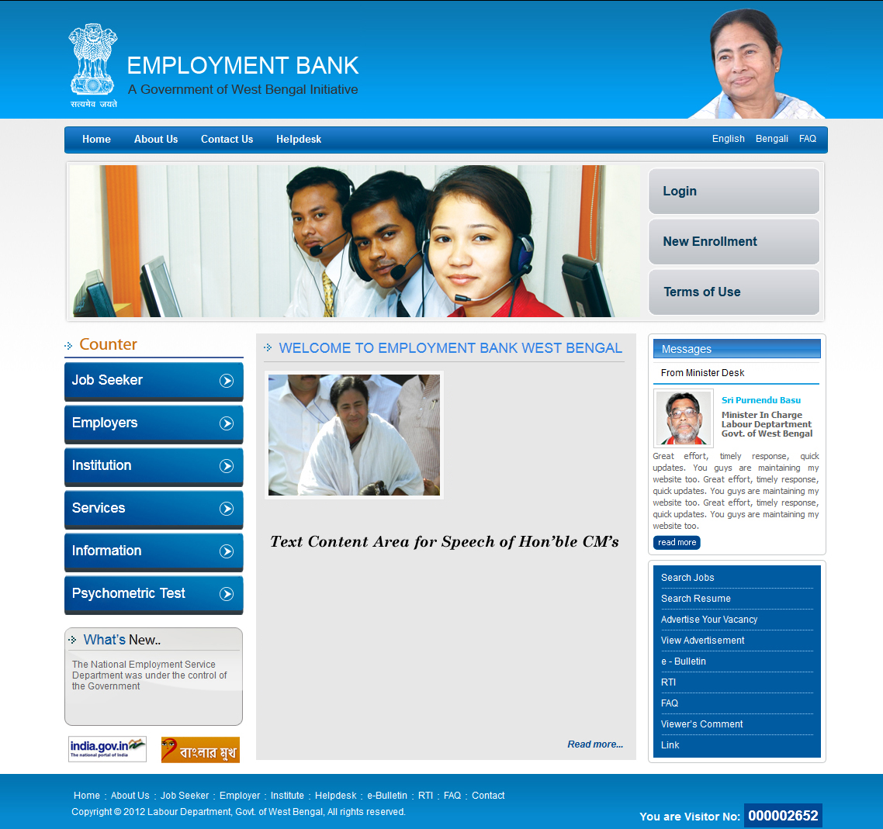

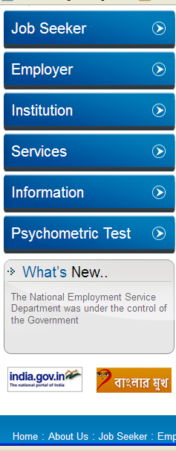




Welcome to
Employment Bank
-the State owned job portal

Slide 2
THE CONCEPT
A State owned interface where the
following parties will be able to
interact online :
Job-seekers
Employers & Placement Agencies
Education & Training providing
Institutions
Service providing & Service-seeking
individuals

Slide 3
SERVICE RECIPIENTS
The Job-seekers
The Employers & Placement Agencies
The Education & Training Providers
The Individuals ( both service – seekers &
service – providers)
General Viewers for information

Slide 4
SPECIALITY OF EMPLOYMENT BANK
FORMATION OF JOB_SEEKERS’ DATABASE
Data uploaded
from various
Education and
Training
Providing
Institutions
posting
of resume by
individual
job-seeker
Direct
posting
of resume by
individual
job-seekers
Employment
Exchanges
database

Slide 5

All services to all stakeholders are provided free of cost
SPECIALITY OF EMPLOYMENT BANK
SPECIALITY OF EMPLOYMENT BANK
Job Advertisement facility for a long period
Selection of employees just on mouse click
Well devised searching and filtering tools
Checked & verified Job-seekers database
Facility for sending sms /email to job-seekers for interview / test
‘Availability – checking’ prior to job-posting
Highly rich ‘job-seekers’ data-base

Slide 6
IMPORTANT TERM FOR PLACEMENT AGENCIES / EMPLOYERS
No Employer / Placement Agency can demand any kind of fee or Service Charge or Training cost from anyone in the list of job-seekers which it obtained from Employment Bank

Slide 7
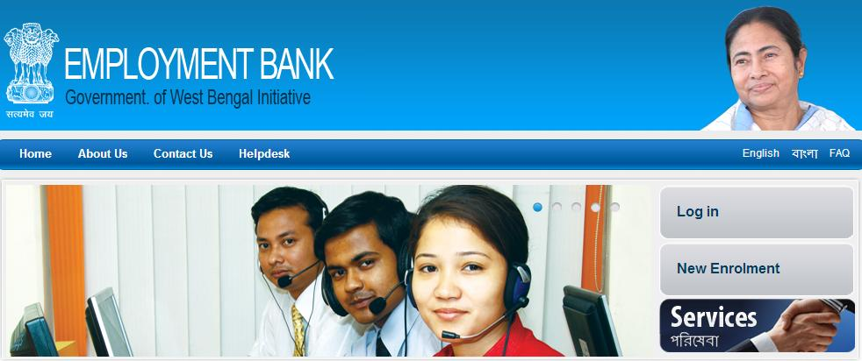
New Enrolment of Employers
Online application for enrolment by uploading necessary details.
Trade License and Proprietor’s PAN Card for Proprietorship Firm, Incorporation Certificate and Company PAN Card for Company etc.
For State/ Central/PSU etc upload authorisation of the Deptt/Directorate etc in favour of the Contact persons
A ‘temporary enrolment number’ will be generated
User ID and password will be generated and sent through e-mail after online-verification by the Directorate of Employment
Post enrolment ‘Job-post’ ,‘Resume – search’ etc using user ID and password
Employers throughout the country can enrol

Slide 8
Employers’ Counter
Employers’ Counter

Slide 9
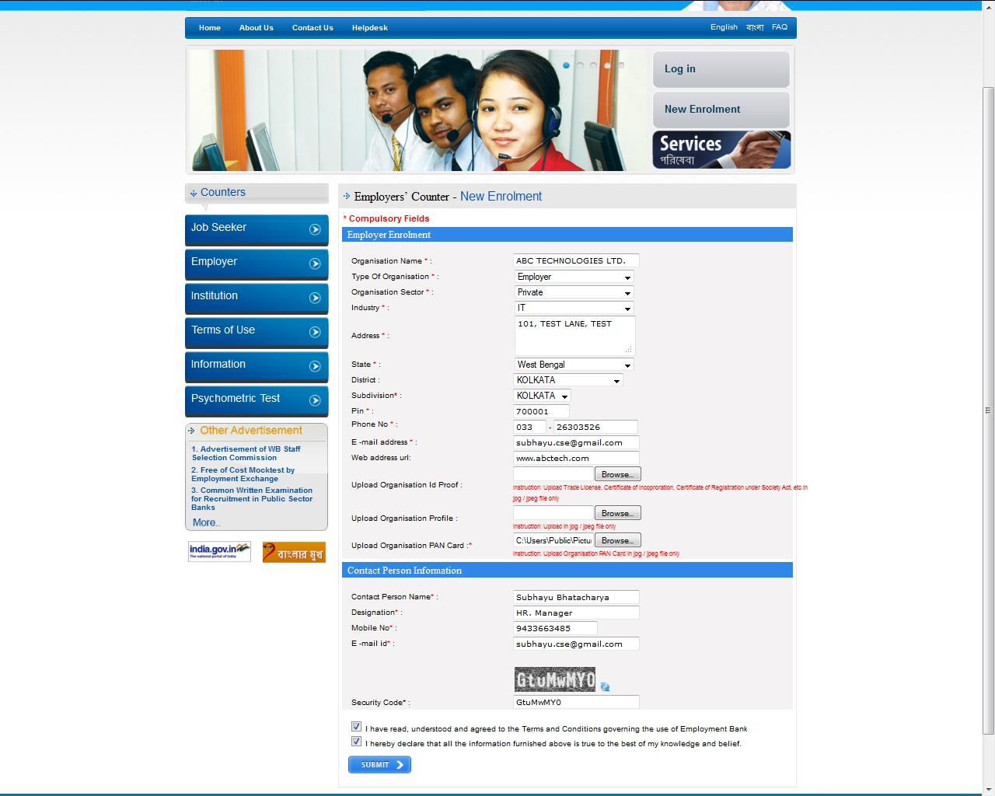

Slide 10
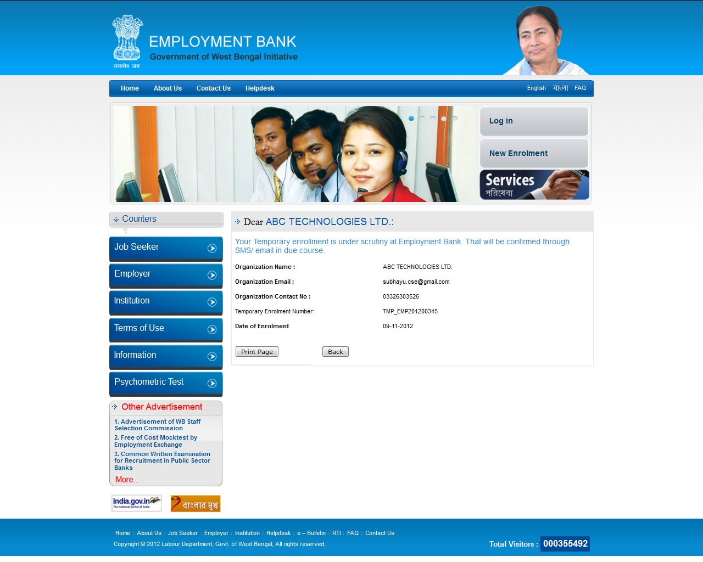
Generation of Temporary Enrolment Number

Slide 11
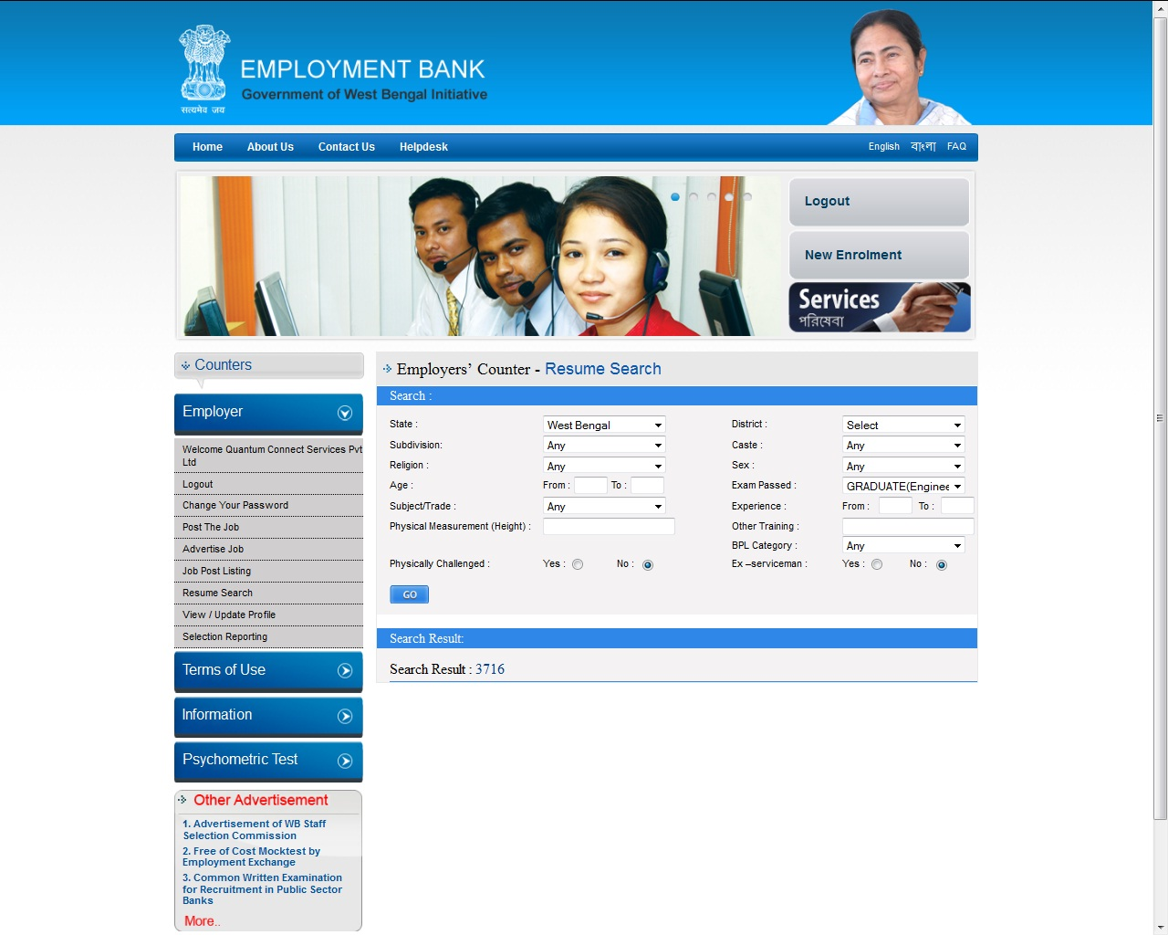
Resume Search
Before posting a job an Employer can use ‘Resume Search’ to check whether job-seekers as per the criteria are available

Slide 12
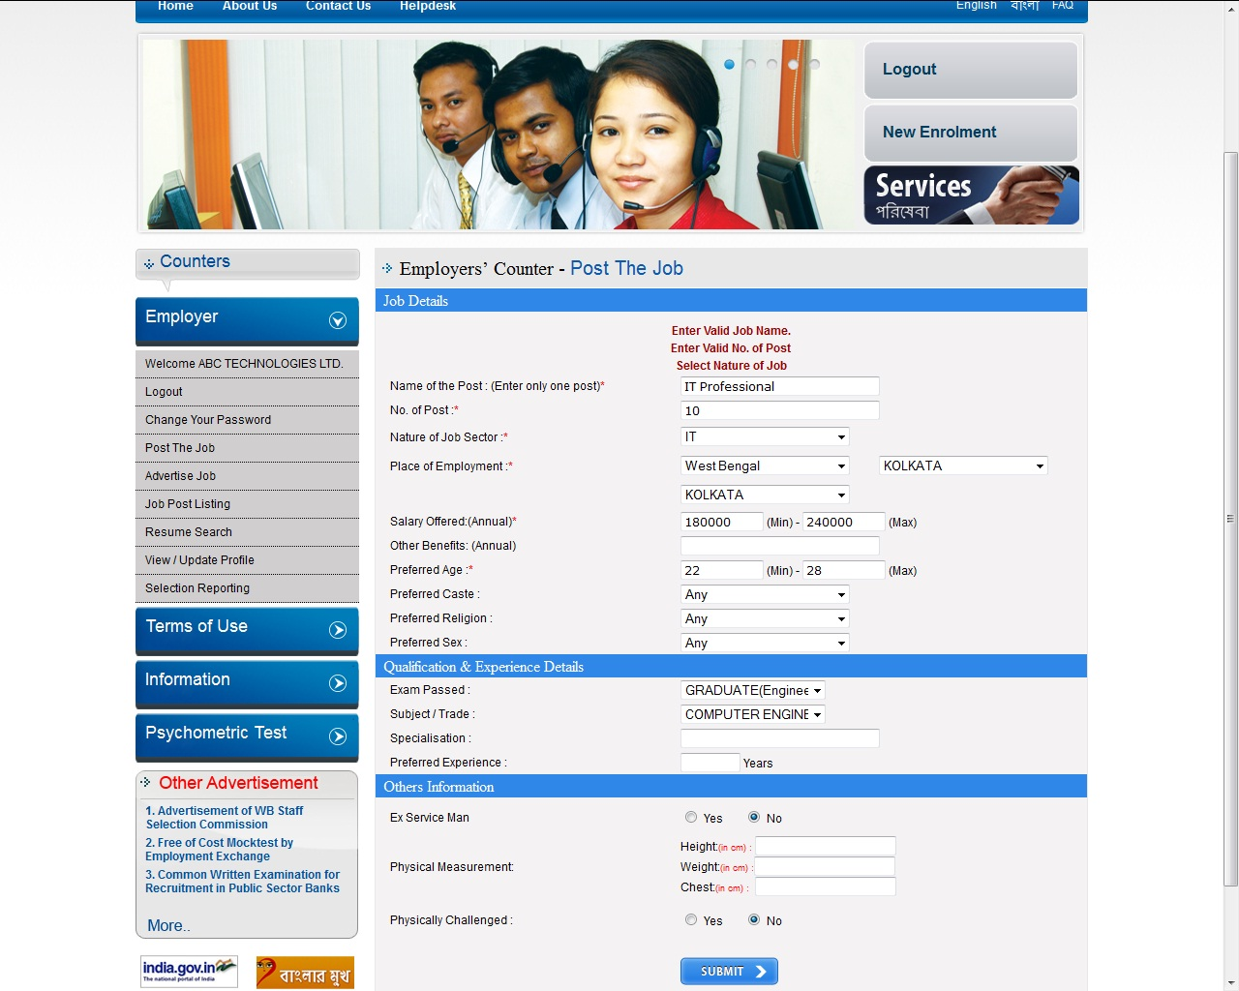
Post the Job
enrolled employers can post the requirement and get list of job- seekers online as per the criteria posted using searching and filtering tools

Slide 13
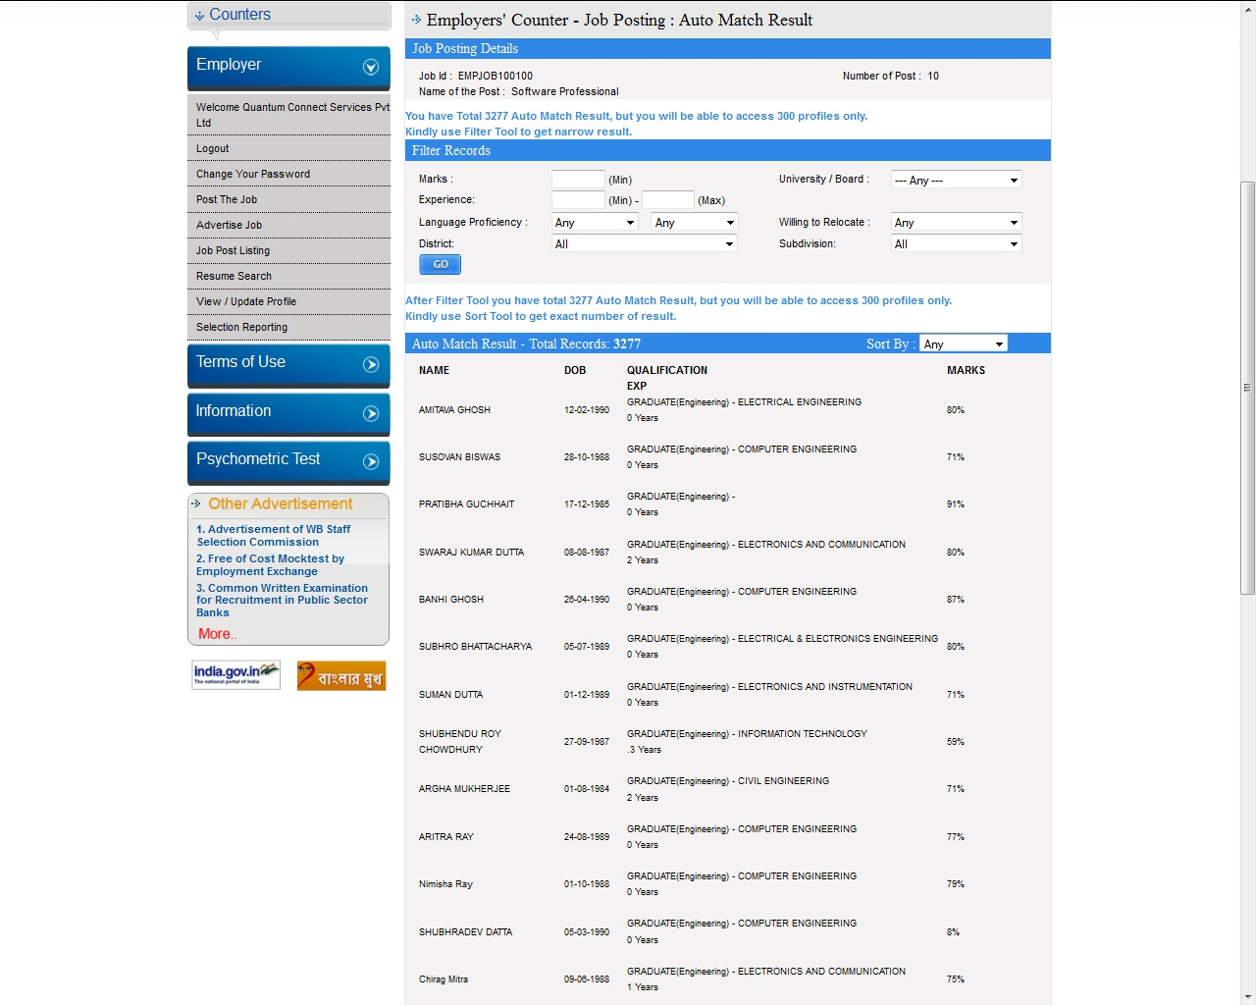

Employers will get names in the ratio 1:30 only. ‘FILTERING
&
SORTING CRITERIA’ are to be used for reaching to such ratio. Full view list will be obtained after that only. Employment Bank will not impose any criteria in the selection process

Slide 14
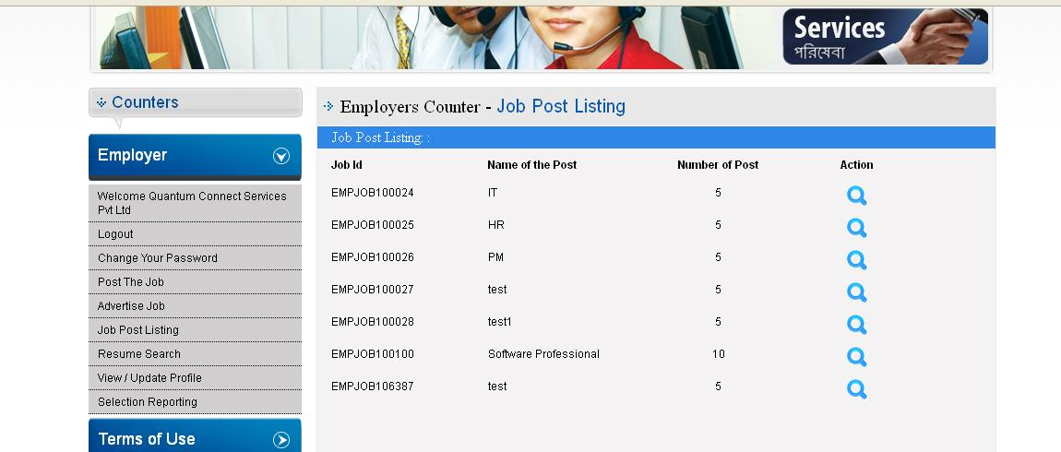
Job Post Listing
All jobs posted by an Employer will be available here

Slide 15
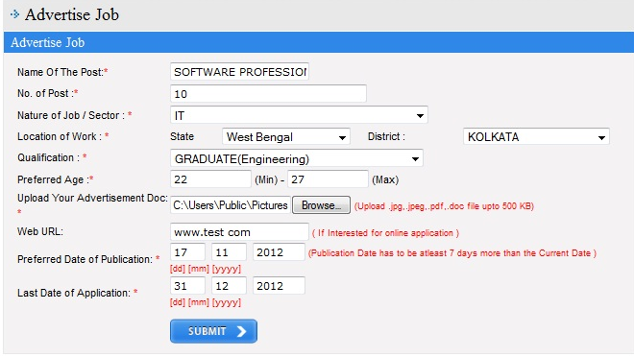
Advertise Job
Employers will be able to advertise any job upto the last date for receipt of application

Slide 16
Education / Training providing Institutions will be able to enroll subject to verification by the offices under the Directorate of Employment
Employers’ Counter
Other Features
Enrolled job-seekers will be able to search jobs posted or advertised by qualification, by location and by sector
Job -Search
Job-Match
Jobs suitable for an enrolled job-seeker will be displayed
Enrolment of Institutions
Before posting a job an employer can use ‘resume search’ to check whether job-seekers as per criteria are available
Group uploading of students’ data
Enrolled Institutions will be able to group upload pass out students’ data

Slide 17
Individuals having skill / expertise in various fields like Masonry, Plumbing, Electrical Works, Domestic Work, Nursing, Private Tution, Interior Decoration, Event Management etc. or Consultants like IT / Legal/ Engineering/ Investment etc. can post their services
Individuals in search of those services can get list of enrolled service-providers on submission of demand

Slide 18




WEB ADDRESS OF EMPLOYMENT BANK
www.employmentbankwb.gov.in

Slide 19
THANK YOU

